Slide 1
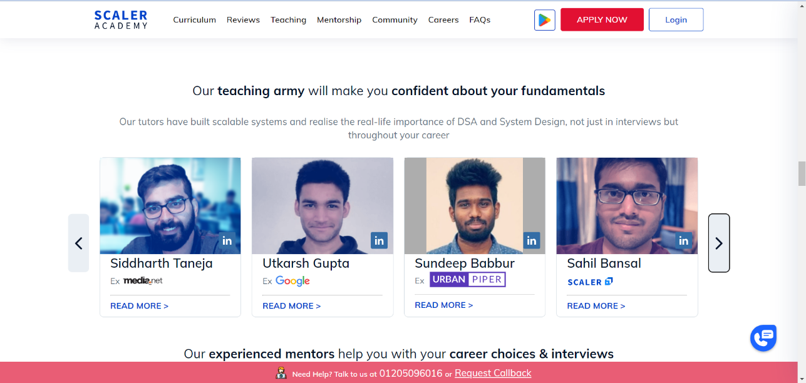
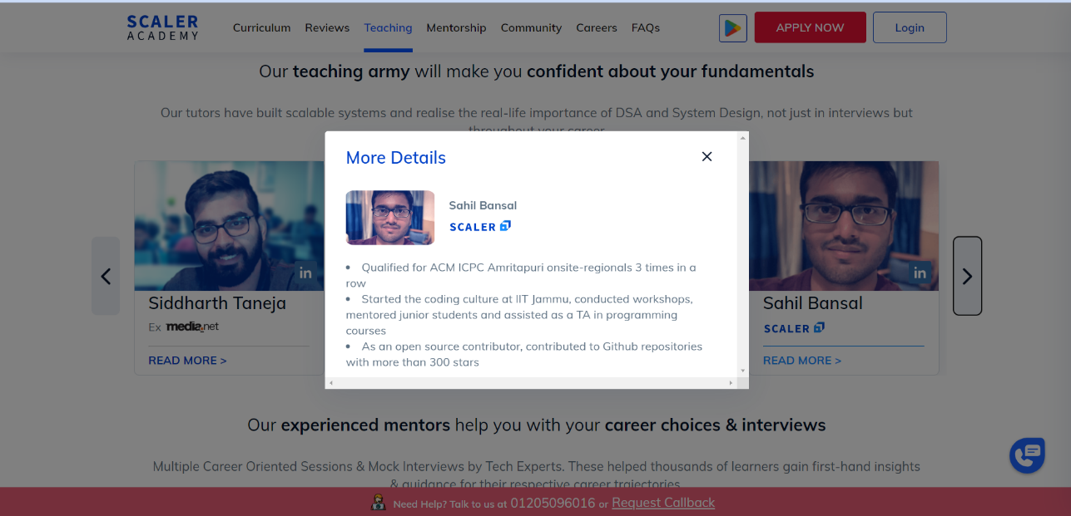
AI Digital Marketing Line Items
Website
  Infrastructure
    Classrooms (pics)
    Labs (pics)
  Location
    Address
    Google Maps
  Links
    App
    Facebook Page / Group
    Youtube
  Online Classes
    Platform
    Pre-recorded Videos (Free & Paid)
  Course Catalogue
    Complete breakdown
    Duration
    Fees
  Mentor Profile
  Job Oriented Prospects
    Schools
    Colleges
    Working Professionals
  Certifications
  Contacts
    Phone
    Email
Mentor Profile
How Anodiam is Different

Slide 2
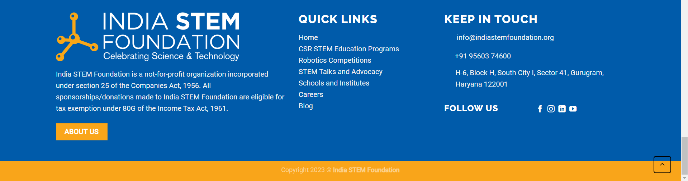
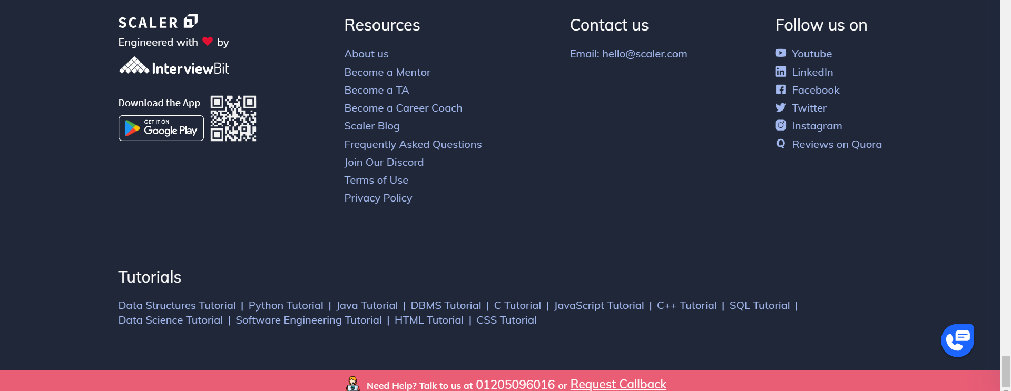
How our footers should look like

Slide 3
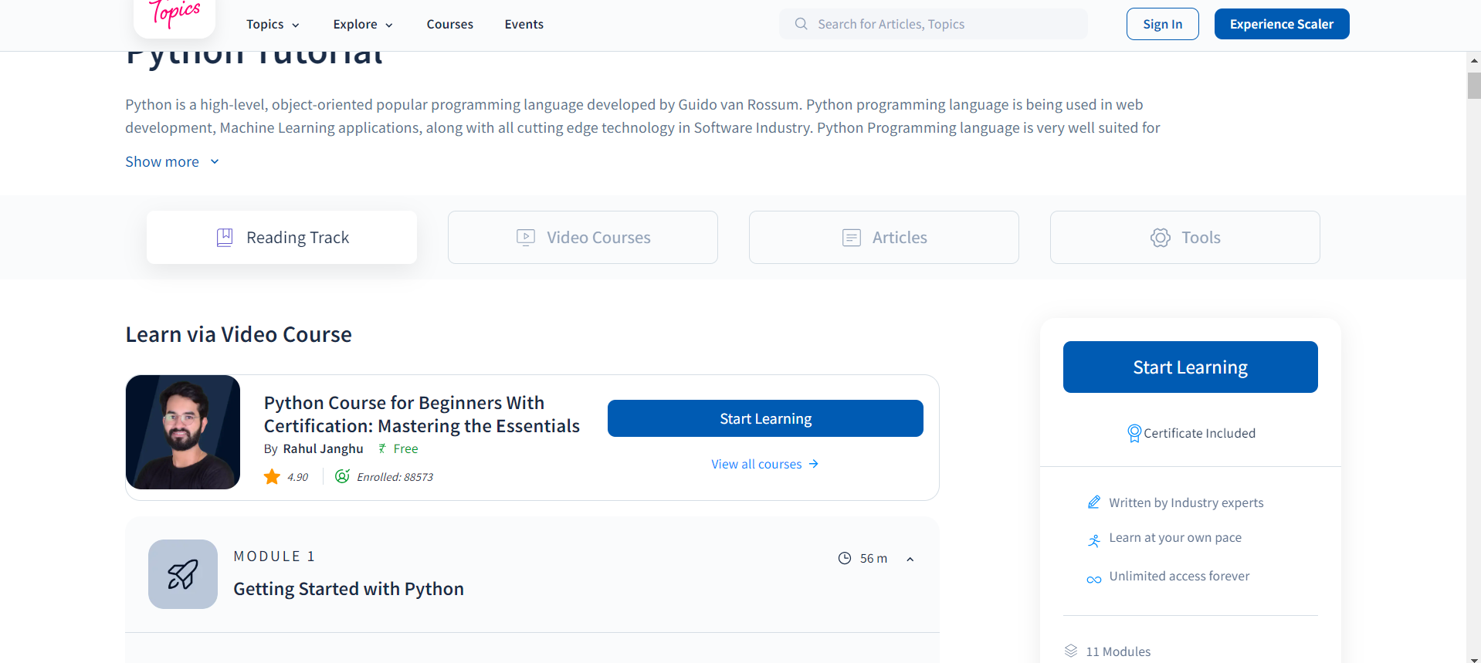
Course Catalogue Page Ideas

Slide 4
User Base
Customers Cluster
  Schools
    Authority
    Teachers
    Parents
    Students
    Parents looking for inclusive education
  Colleges
    Authority
    HOD, TPO, Professors
    Students
    Parents
  Working Professionals

